Slide 1
Presentation title
Presenter name

Slide 2
RHSIB CAS
Lesley Morter

Slide 3
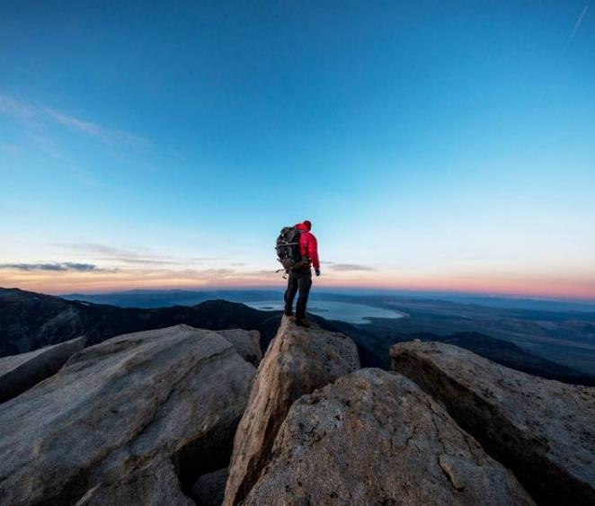
Agenda
PURPOSE
REQUIREMENTS
TIMELINE
Q & A

Slide 4
Introduction
CAS is the heart of the Diploma Programme
With its holistic approach, CAS is designed to strengthen and extend student’s personal and interpersonal being.

Slide 5
CREATIVITY
Explores and extends ideas leading to an ORIGINAL or interpretative product or
performance.
EXAMPLES: Performances in the area of theater, music, or dance. A product in fashion, 2-D art, 3-D art, decorating/interior design, planning an event, etc.
STUDENTS CAN TAKE ANY PERFORMING ART OR FINE ART CLASS WITH THE EXCEPTION OF IB VISUAL ARTS, AND IT WILL COUNT TOWARD CREATIVE HOURS! THIS INCLUDES FLVS CLASSES. ☺

Slide 6
ACTION
Student participates in an activity in which physical exertion that contributes to a healthy lifestyle related to a physical well-being.
EXAMPLES: Working out at the gym, participating in a yoga class, playing organized sports, 5K run, etc…
STUDENTS CAN TAKE ANY P.E.CLASS, AND IT WILL COUNT TOWARD ACTION HOURS! THIS INCLUDES the H.O.P.E. class via FLVS.

Slide 7
SERVICE
Student participates in a collaborative and/or reciprocal
engagement with the community in response to an AUTHENTIC need. This usually addresses a social issues or addresses a special population. It is done outside of the regular school day.
Examples: Any non-profit organization. Students can work with a house of worship to complete the service. Typically, they can volunteer for a cultural or civic organization even if it is a not-for profit. If you have questions, see me.

Slide 8
Learning Outcomes
1. Identify your own strengths and develop areas for personal growth.
2. Demonstrate that challenges have been undertaken, developing new skills in the process.
3. Demonstrate how to initiate and plan a CAS experience.
4. Show commitment to and perseverance in CAS experiences.
5. Demonstrate the skills and recognize the benefits of working collaboratively.
6. Demonstrate engagement with issues of global significance.
7. Recognize and consider the ethics of choices and actions.

Slide 9
CAS PROJECT
REQUIRED Collaborative project during your Junior/Senior year that allows students to show initiative, perseverance and problem-solving.
collaborative in nature between a group of students or with members of a wider community Student must work as a team and made responsible for, or to initiate, or be a part of the entire CAS Project.
They must collaborate with other high school-age students, but they do not have to be from RHSIB.

Slide 10
CAS PROJECT - Continued
Defined purpose and goal
Identify one or more learning outcomes (There are 7)
Minimum of one month in length from beginning to end
Minimum of 20 hours in length
Must be written out and presented (in a classroom, on their social media account (not tik-tok), or a recording of a live performance

Slide 11
CAS PROJECT STEPS (IPARD)
Investigation - needs, interests, skills and areas of personal growth
Preparation - clarifying roles and plans of action
Action - plan idea into a project
Reflection - describe what happened, feelings, ideas, raising questions
Demonstration – implementation of the project

Slide 12
REFLECTION – Required for all CAS entries
Reflection is the vehicle to personal growth in a CAS experience.
It must be meaningful, honest, personal and create self-awareness through feelings and thoughts.
This can be completed through different forms of expression - either by journaling in Managebac, taking photographs of activities and reflection through writing, or creating a short video that summarizes the CAS experience.

Slide 13
CAS Requirements / Recommendations by grade level
GRADE LEVEL | CREATIVITY | ACTION | SERVICE | CAS PROJECT
FRESHMEN | 5 | 5 | 20 | NOT REQIRED
SOPHOMORES | 5 | 5 | 20 | NOT REQUIRED
JUNIORS | 10 | 10 | 30 | RECOMMEND THEY START
SENIORS | 10 | 10 | 30 | MUST COMPLETE 20 HRS BY APRIL 1, 2024
TOTAL | 30 | 30 | 100 | 20 HRS – included in and NOT an addition to the requirements listed here.
These are slightly different requirements from before. This will be shared with the students.

Slide 14
TIMELINE
9th Grade Orientation – CAS & Managebac – FALL 2023 through Thinking Skills Class
10th Grade New to RHSIB Orientation CAS & MANAGEBAC - First week of school
11th grade – CAS Project Information – WINTER 2024 through TOK Class
12th Grade – REMINDERS of CAS Project – October / November 2023 through TOK Class
PLEASE USE CLUB DAY AS YOUR MENTAL DEADLINE TO GET CAUGHT UP ON ALL THINGS CAS!
REMINDERS WILL BE SENT OUT BEFORE CLUB DAY TO CHECK MANAGEBAC
THERE ARE 475 OF THEM AND ONE OF ME! I CAN’T DO IT ALONE. I NEED YOUR HELP. IF WE DIVIDE AND CONQUER, WE WILL SHARE THE SUCCESS, AND STUDENTS WILL BE FAR LESS STRESSED. THIS TRICKLES DOWN TO THEIR PARENTS! ☺

Slide 15
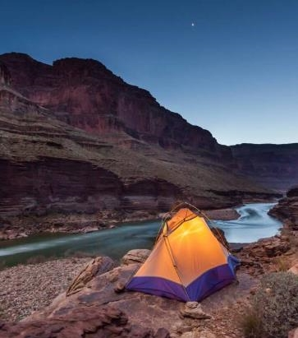
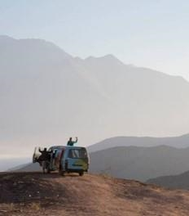
Summary
CAS needs to be authentic.
CAS needs to be continuous.
CAS needs to include all learning outcomes.
CAS needs to be meaningful and important

Slide 16
Thank you
Lesley Morter
RHSIB
MORTERBOARD.COM

