Slide 1
Hillsborough High School junior Night
Tuesday March 21, 2024
Lisa Sigmon, IB Diploma Program Coordinator
Lesley Morter, School Counselor, IB Program
Notes:
This PowerPoint will be posted on the RHS Student Services Canvas course for future reference.
The 2025 Handbook is also an important resource you should keep handy.
Another resource that contains tons of helpful information is the RHS Student Services Canvas course. Check it regularly!

Slide 2
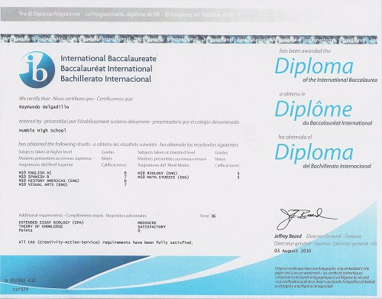
How do I get my IB DIPLOMA?
IB SUBJECTS
+
CORE ELEMENTS

Slide 3
IB Diploma requirements
Earn a minimum of 24 points
(3 HL courses + 3 SL courses)
At least 12 points must be earned in the HL courses
At least a D in your EE & TOK

Slide 4
How subjects are graded
from 7 to 1, with 7 being highest
1-3: no pass
+5: High achievement
How the core is graded
EE AND TOK from A- E, with E being not passing
CAS: Requirements have been fully satisfied

Slide 5
SPANISH B SL
GRADE COMPONENTS
BIOLOGY HL SL
AI ORAL 25%
PAPER 1 25%
PAPER 2 50%
Reading 25%
Listening 25%
AI 20%
PAPER 1: 20%
PAPER 2: 36%
PAPER 3: 24%

Slide 6
INTERNAL ASSESSMENTS (IAS)
Every point counts!
Deadlines!
It is a graduation requirement!

Slide 7
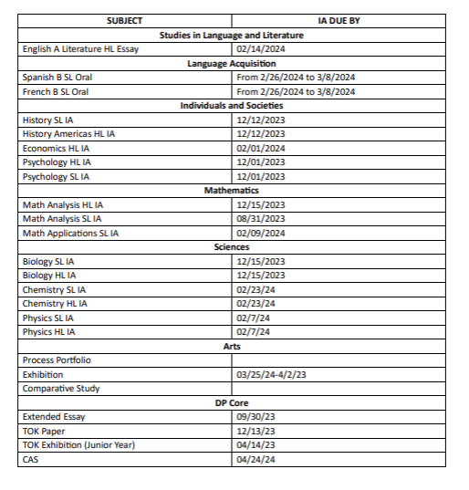
IAs DEADLINES

Slide 8
External Assessments
All External Assessments are taken at the end of senior year in April/May.
External assessments are graded by moderators in various parts of the world.
Student Takes EA at End of Senior Year
Exams are Sent to Moderators

Slide 9
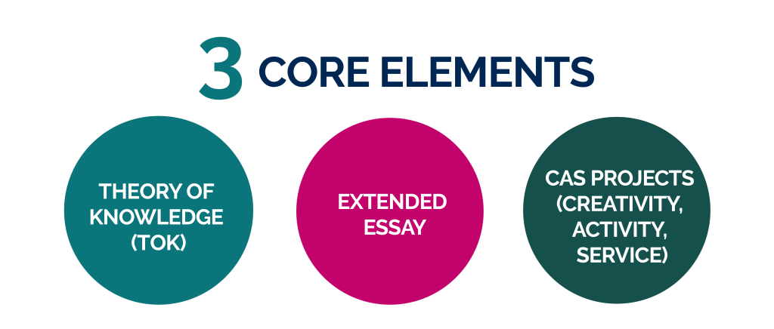
DP CORE
The theory of knowledge (TOK) and extended essay (EE) components are awarded individual grades and, collectively, can contribute up to 3 additional points towards the overall diploma score.

Slide 10
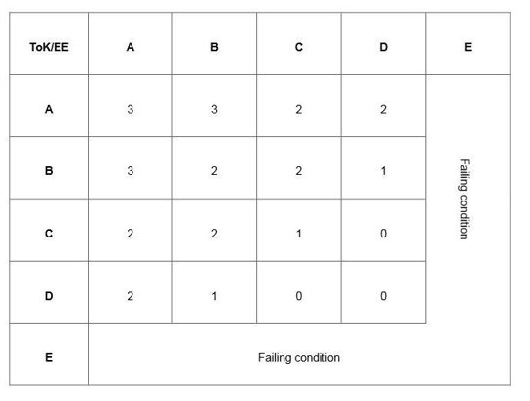
EE AND TOK

Slide 11
Cas hours
Creativity, activity, service (CAS) – the remaining element in the DP core – does not contribute to the points total but authenticated participation is a requirement for the award of the diploma.

Slide 12
CANDIDATE 003352
English A Lit HL | 4
History Americas HL | 4
Economics HL | 3
Spanish B SL | 4
Biology SL | 5
Mathematics applications SL | 6
Economics EE | D
TOK | D
CAS | Requirements have been fully satisfied
Total points: 26

Slide 13
CANDIDATE 003352
English A Lit HL | 4
History Americas HL | 4
Economics HL | 3
Spanish B SL | 4
Biology SL | 5
Mathematics applications SL | 6
Economics EE | D
TOK | D
CAS | Requirements have been fully satisfied
Total points: 26

Slide 14
CANDIDATE 003358
English A Lit HL | 4
History Americas HL | 4
Economics HL | 3
Spanish B SL | 4
Biology SL | 4
Mathematics applications SL | 4
Economics EE | D
TOK | D
CAS | Requirements have been fully satisfied
Total points: 23

Slide 15
CANDIDATE 003358
English A HL | 5
History Americas HL | 4
Psychology HL | 5
Spanish B SL | 5
Physic SL | 2
Mathematics applications SL | 6
EE | D
TOK | C
CAS | Requirements have been fully satisfied
Total points: 25

Slide 16
CANDIDATE 003358
English A HL | 5
History Americas HL | 4
Psychology HL | 5
Spanish B SL | 5
Physic SL | 2
Mathematics applications SL | 6
EE | D
TOK | C
CAS | Requirements have been fully satisfied
Total points: 25

Slide 17
HOW CAN YOU IMPROVE YOUR CHANCES OF GETTING THE ib diploma?
1. Communicate with teachers
2. Get familiar with the exam rubrics
3.Be conscious of the quality and deadlines of the IAs/ TOK/ EE
4. All subjects/points count
5. Look for intrinsic motivation beyond the diploma. Do it for yourself!

Slide 18
Let's Apply to College
Helpful Links can be found on
MORTERBOARD.COM

Slide 19
Important Dates
June/July Some college applications open
August 1 Most college applications open
Common App opens
September 1 Student Brag Sheet due to counselor
October 1 FAFSA opens
Bright Futures/FFAA application opens
Submit requests for transcripts, recommendation letters and Common App
October 15 FSU Early Action Deadline
November 1 UF (and many more) Application Deadline
December 1 FSU Regular Decision Application Deadline
*Application Deadlines are subject to change.
Notes:
October 1 is the preferred deadline for requests for transcripts, letters and Common App

Slide 20
Laying the foundation
Timeline: Spring of Junior Year

Slide 21
What should be happening Now?
Prepare for a
Strong
Senior Year
Practice and register for
ACT and SAT
Complete
CAS Hours
Build Your Resume

Slide 22
Senior Schedule and Grades
BALANCE. Plan a senior year that considers coursework, additional work of college applications and extracurricular activities. Do not be your own worst enemy by over scheduling yourself or procrastinating important tasks. Senioritis is a “thing!”
DEDICATION. When applying, your transcript will show your semester grades and cumulative GPA from 9th-11th grade. Finish strong. Colleges will review your final transcript and will rescind offers for poor performance (i.e., D’s, F’s).
COMMITMENT. Have a strong and consistent commitment in your approach to academics your senior year. It will pay off when you get to college (AND BEYOND).

Slide 23
SAT/ACT Practice TIP: Implement a practice plan now. Test scores play a big role in college admissions and scholarships.
SAT Practice Websites
CollegeBoard.org
KhanAcademy.org
ACT Practice Websites
Academy.act.org
ACT.org
PSAT - Studentscores.collegeboard.org

Slide 24
SAT and ACT Registration
2024 Test Dates (prior to applying)
Try BOTH tests!
SAT (collegeboard.org) | ACT (actstudent.org)
May 4, (registration deadline: 4/19/24) June 1, (registration deadline: 5/16/24 | June 8 (registration deadline: 5/3/24) July 13 (registration deadline 6/7/24)
Notes:
Juniors take the SAT on April 10th.
The remaining test dates for this year PRIOR to applying to colleges are listed for you on this slide.
Try both tests! Students often do better on one test the other.

Slide 25
School/Academic Resume
What should be included?
Athletics
Academics - GPA/test scores/class rank
Awards
Extra curricular activities
Volunteer hours
Work experience
Hobbies
Special skills (i.e., multilingual, certifications, other talents)
Special circumstances
TIP: A resume is more than just a list of activities. Reflect on each activity:
How have you contributed/demonstrated leadership?
What was meaningful and why?
How might the activity align with career interests or campus opportunities?
Brag sheets are available in the Guidance Office.
Notes:
Continue to update your resume/activities list and save it for easy access.

Slide 26
Building a college list
Timeline: Spring of Junior Year/Summer before Senior Year

Slide 27
Researching Colleges
Register for Virtual College Fairs at nacacfairs.org. Two options available for spring March 24, 2024, 1:00 PM – 6:00 PM OR April 21, 2024, 1:00 PM – 6:00 PM
Check HHS Student Services Canvas Page for announcements and watch for in-school college visits.
Review admission requirements on college websites.
Consider characteristics like size, location, public/private, degree programs offered, etc. Visit college campuses. Choose the college that fits YOU.
Join prospective schools’ email list. Don’t forget that some school will track interest, so let them know you are interested.
Look for Fly-in Programs for lower-income families as they are often free!

Slide 28
Say hello to Xello
Xello is an engaging online program that helps students build the skills, knowledge and plans to be future ready. The program uses an investigative, discovery-based learning process. Students better understand themselves, their future career options, and the 21st century skills they’ll need to succeed.
On Xello you can…
Take career assessments
Complete college searches
Explore career possibilities and educational pathways
View local scholarship applications
Define skills, preferences, learning styles, and aspirations
Engage in interactive lessons to ensure success in school and beyond.
Students log in through their HCPS Clever accounts
Notes:
If your school uses SSO, students securely sign in to Xello from the SSO platform. If your school doesn't use SSO, students sign in at https://login.xello.world using the format found on your educator dashboard. Modify this slide if needed.
Project your screen as you model how to navigate to the first lesson (or prerequisite activities) for your students using your demo student account.
You can also add your own screenshot of where your students log in to help guide them.

Slide 29
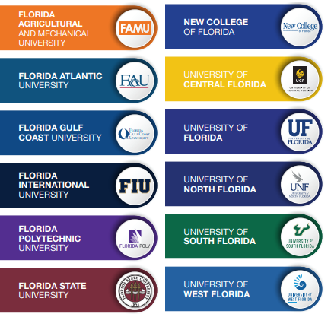
Colleges consider
GPA - Recalculated by the institution
Academic Rigor
ACT/SAT scores
Class rank
Extracurriculars
Essay – if required
Recommendation – if required
Notes:
Most Colleges will recalculate your GPA using their own Academic Index. They typically use your core classes: English, Math, Science, Social Studies & World Language
Meet vs. Exceed course requirements, including in World Languages

Slide 30
Finalizing the Details
Timeline: Summer before Senior Year/Fall of Senior Year

Slide 31
How many Colleges should I apply to?
Experts suggest between 4 and 15. We recommend at least one of them should be in the state of Florida to access Bright Futures. Keep in mind that some institutions will require supplemental essays that are typically specific to that institution. This can be time consuming.
Find the best fit for you academically, socially and financially.
A Balanced List of schools should include:
REACH Schools – competitive stretch
TARGET Schools – meet admissions criteria
SAFETY Schools – almost certain admission
Notes:
Expert opinions vary, ranging from four to fifteen. College Board suggests students apply to between four and eight.
Consider time and money! Applications take time to complete. Application fees range from $45-$100 per school.
Do your research to limit your list.
Also consider academic and social supports offered at the college.
REACH Schools – competitive stretch for the applicant
TARGET Schools – Student’s academic credentials are well-within the admissions criteria
SAFETY Schools – Almost certain admission

Slide 32
Application Types and Deadlines
Early Action – an accelerated college application process usually due around the first of November with decisions arriving December/January.
Early Decision – like EA, but much more restrictive; can only apply to one college through early decision & it’s binding (MUST attend if admitted and there is a financial comitment).
Restrictive Early Action – Like ED, but without the financial commitment. It is still a binding agreement.
Regular Decision – regular admissions cycle; applications usually due by January/February; decision usually arrives in March/April.
Rolling Admission - admissions decisions are made as applications are received; apply as early as possible
Notes:
Take your list of schools and research the college admissions options at each one. Make a plan. Weighing your options can be difficult so start early.
Early Action – shows college student is interested, which can go a long way with admissions; having a decision earlier in the year can alleviate stress; usually can still weigh offers from other colleges and make their final decision in the spring; may not want to do this if student plans to strengthen their application by improving their grades in the fall of senior year
Early Decision – not recommended for students if finances are an important factor because they can’t compare admissions and financial aid offers
Regular Decision - colleges typically review all applications received before the deadline as a group to select the incoming class; Consider - does the college typically admit a large portion of the incoming class from the early applicant pool? Is this the student’s top choice school? If the answer is yes, then they should consider applying early
Rolling Admission - once the class is full, colleges may stop accepting applications; PAY ATTENTION to specific college scholarship deadlines!
(College Well, 4 Common Types of College Admissions Options, Joanne Dashiell)

Slide 33
What is common application?
A standard application form that is accepted by over 1000 colleges in lieu of their application.
Visit Common App.org for a complete listing of colleges that accept this application.
You can use Common App if two or more colleges you are applying to accept it.
WHAT IS THE HBCU COMMON APPLICATION?
Similar to Common App – one application for multiple schools
One fee of $20 covers all applications to any of the 66 HBCU’s on their list.
Visit commonblackcollegeapp.com
Notes:
Students will invite their school counselor when using Common App – be sure you have their correct name and email. Students should complete a Brag Sheet and return it to their counselor. The information provided is used when completing the counselor portion of Common App.
Common App Essay Prompts are included in the Class of 2024 Handbook
Common App retained the optional COVID-19 question for the graduating class of 2023. Students can explain has COVID-19 has affected them personally, academically, socially, etc. It can be found in the ADDITIONAL INFORMATION section.

Slide 34
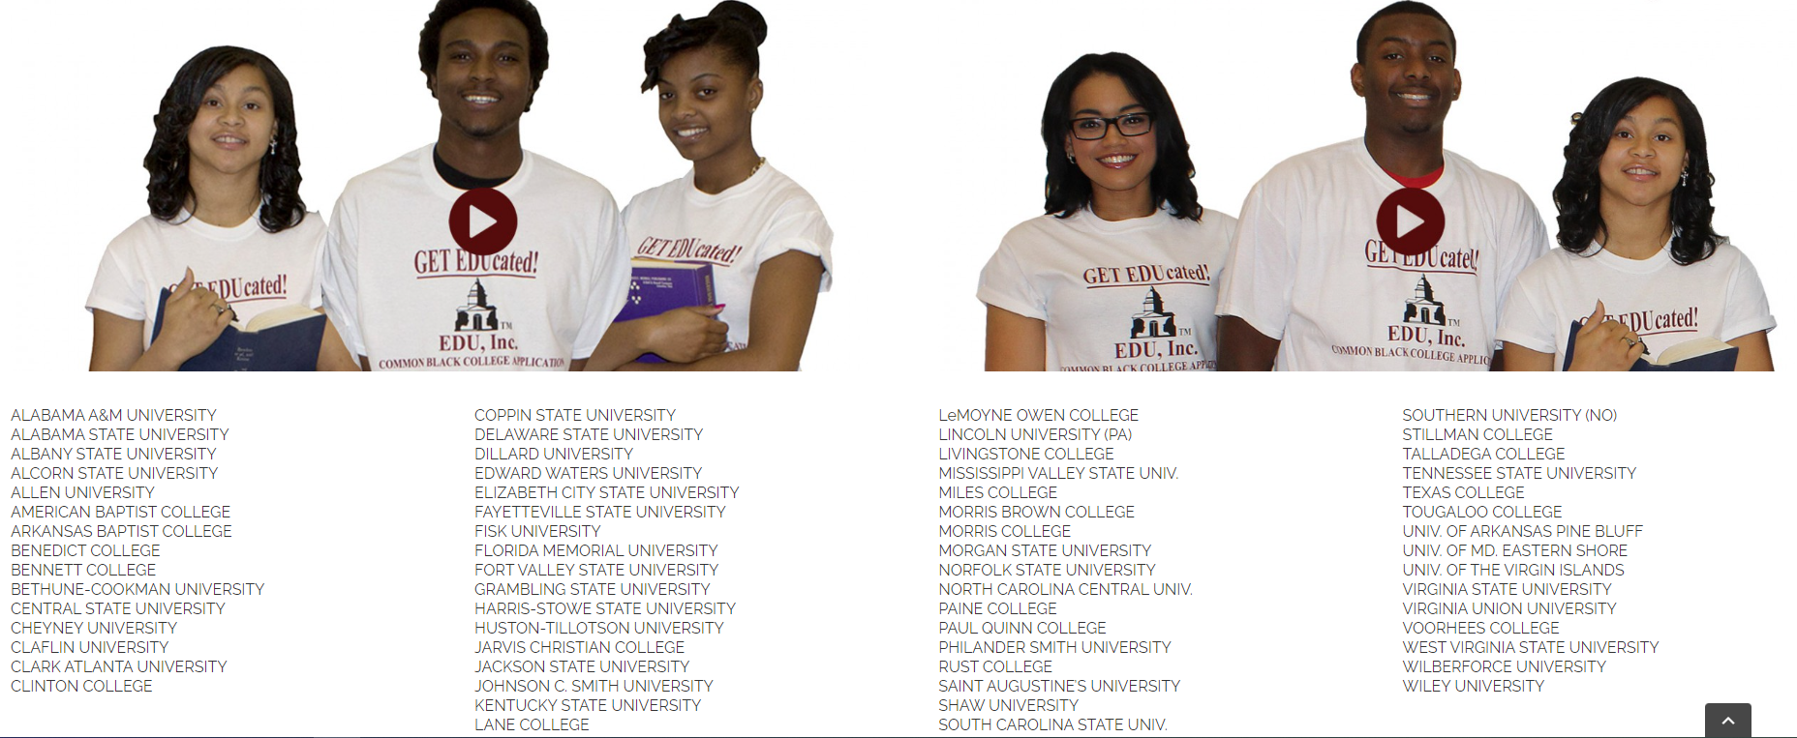
Common Black College application

Slide 35
College application process
Students apply for college in the fall of their senior year.
STEP 1: Submit your college application on the college’s website or on Common App.org – This sounds easy, but it can get stressful if you do not PLAN!
STEP 2: Request your SAT or ACT scores to be sent to each college. Send scores directly from Collegeboard (SAT) (www.collegeboard.org) or ACT (www.act.org).
STEP 3: Send transcripts:
*Common App – uploaded by school counselor
*Self-Reported Student Academic Record
* Institution Apps typically use secure platforms whereby you enter your counselor’s name, and they will send the counselor a link to upload transcripts.
Notes:
Most applications open August 1st
Make sure you submit all required materials such as essay, resume, application fee, etc.
Test scores do NOT appear on student transcripts. Scores can take 2-4 weeks to get to the college so request EARLY! Students may self-report if allowed.
Official transcripts include all high school courses taken with semester grades earned, GPA, rank in class, and senior year schedule.
Many schools request a Self-reported Student Academic Record instead of a transcript – students must input their grades manually.
If using Common App, your counselor will upload your transcript.
Students must request the transcript well in advance of the application deadline.
Dual enrollment students must also request that HCC send an official copy of your transcript (online through Hawknet).
Most students are done with the application after Steps 1-3.
Most Florida public universities do NOT request letters of recommendations.
Check your specific college to see if you need a recommendation. Complete a Student Brag Sheet, return it to your recommender, and kindly request a letter from the recommender. Allow them 2 weeks to complete the letter - do NOT wait until the last minute!
You should work on your Brag Sheet over the summer. Consider which teacher(s) you will ask. You can ask them if they are willing to write you a recommendation letter before this school year is over.

Slide 36
COMMON APP ESSAY
Below is the full set of essay prompts for 2024–2025.
Some students have a background, identity, interest, or talent that is so meaningful they believe their application would be incomplete without it. If this sounds like you, then please share your story.
The lessons we take from obstacles we encounter can be fundamental to later success. Recount a time when you faced a challenge, setback, or failure. How did it affect you, and what did you learn from the experience?
Reflect on a time when you questioned or challenged a belief or idea. What prompted your thinking? What was the outcome?
Reflect on something that someone has done for you that has made you happy or thankful in a surprising way. How has this gratitude affected or motivated you?
Discuss an accomplishment, event, or realization that sparked a period of personal growth and a new understanding of yourself or others.
Describe a topic, idea, or concept you find so engaging that it makes you lose all track of time. Why does it captivate you? What or who do you turn to when you want to learn more?
Share an essay on any topic of your choice. It can be one you've already written, one that responds to a different prompt, or one of your own design.

Slide 37
Need help writing a good essay?
Essays That Worked | Johns Hopkins University Admissions (jhu.edu)

Slide 38
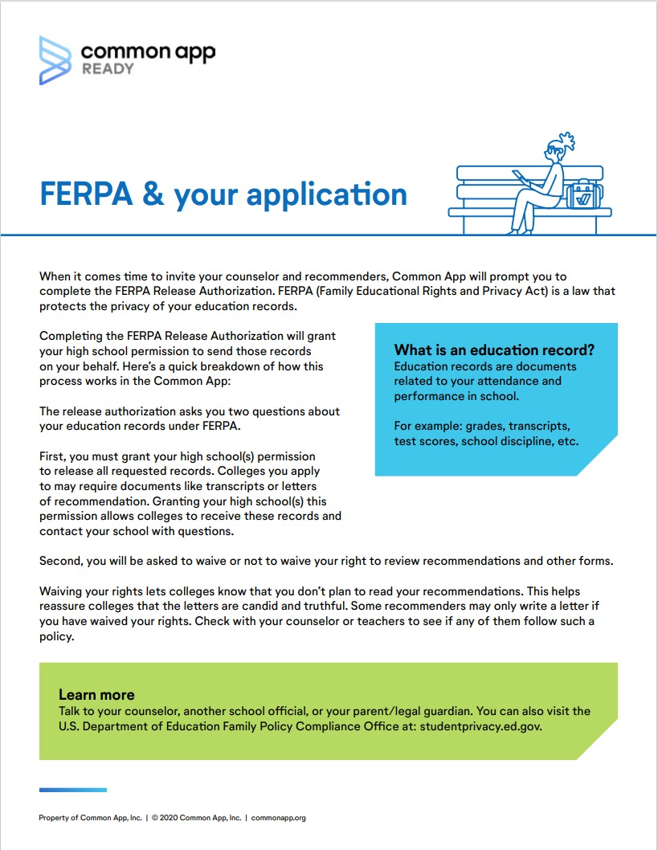
FERPA
FERPA Release Authorization grants your high school permission to release all requested records on your behalf
Waiving your rights to review recommendations or other forms lets colleges know that you will not read recommendations. They know the letter of recommendation is more authentic if the student is not reading it.
Notes:
FERPA Release Authorization grants your high school (counselors and recommenders) permission to release all requested records on your behalf. Records such as Transcripts and letters of recommendations.
Waiving your rights to review recommendations or other forms lets colleges know that you will not read recommendations. They know the letter of recommendation is more authentic if the student is not reading it.

Slide 39
Military Options
Research different branches
Speak with ROTC instructors and service recruiters
Investigate ROTC opportunities
Take the ASVAB
Pass the medical and physical exams
Meet with a service enlistment counselor
Take the Oath of Enlistment
Academy appointment process starts the junior year. If you are considering a military academy, START now by seeing your school counselor.
Notes:
Speak with an ROTC instructor and/or see the Websites listed in your handbook for detailed information about the military.
If you are interested in joining a military academy, speak with an ROTC instructor.
ARMED SERVICES VOCATIONAL APTITUDE BATTERY (ASVAB) is offered at no cost and no obligation to high school students. ASVAB scores qualify a student for certain jobs and training in the Armed Forces.

Slide 40
PAYING FOR Postsecondary Education

Slide 41
Application Fee Waiver

Slide 42
Financial aid
Money to help pay for college.
To qualify, you MUST apply!
Sources of Financial Aid
Federal government
State government
Academic institutions
Private organizations
Banks and lending companies
Notes:
Financial aid is money that the government and other organizations give you or lend you so you can pay for college.
To qualify for financial aid, you MUST apply!
Sources
The federal government (the largest source)
Academic Institutions - Most college or universities offer financial aid packages
Private organizations, such as companies, clubs and religious organizations
For additional information, see the Financial Aid module on the RHS Student Services Canvas course.

Slide 43
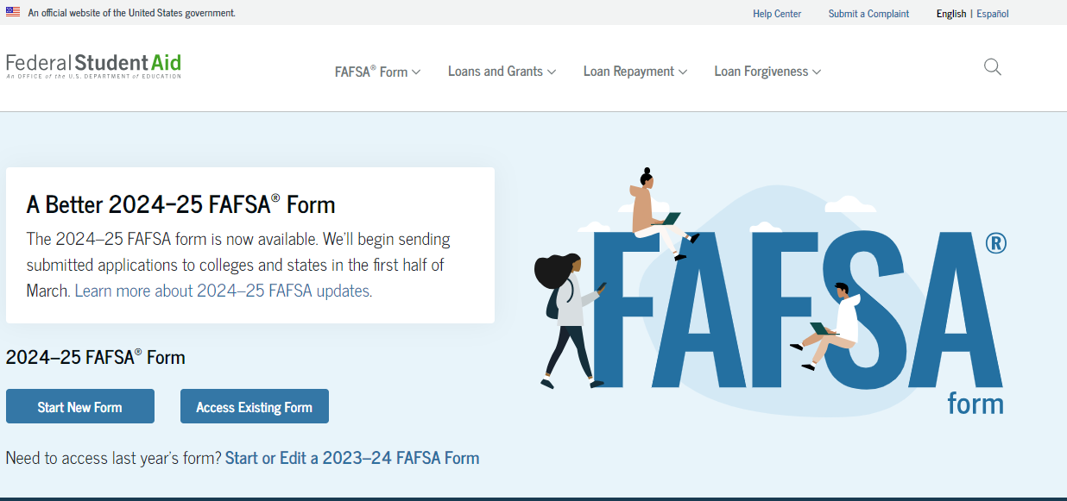
FAFSA
Expected to open in October 2024
Notes:
Financial aid is money that the government and other organizations give you or lend you so you can pay for college.
To qualify for financial aid, you MUST apply!
Sources
The federal government (the largest source)
Academic Institutions - Most college or universities offer financial aid packages
Private organizations, such as companies, clubs and religious organizations
For additional information, see the Financial Aid module on the RHS Student Services Canvas course.

Slide 44
Four main types of financial aid
Grants
Most are need-based funds that come from federal or state governments and from colleges. Grants do not have to be paid back.
Scholarships
Awards provided by government, colleges or organizations which have specific criteria based on achievement, talent, need, merit or group membership. Scholarships do not have to be paid back.
Loans
Provided by government, banks, or lending companies. It is borrowed money that must be paid back with interest.
Work‐Study Programs
Federal program that offers paid part-jobs to students with financial need. Jobs are usually on campus.
For more information and specific examples, refer to the 2024 Handbook.
**For more information and for specific examples, refer to your handbook**

Slide 45
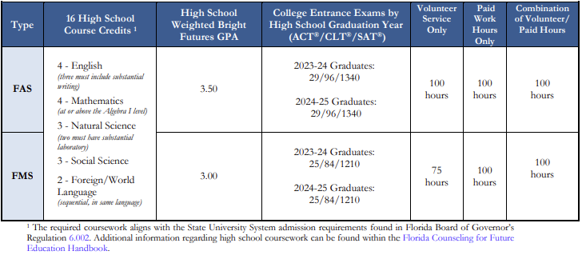
Florida bright futures scholarship program 2023-2024 info
Notes:
Bright Futures provides scholarships based on high school academic achievement. The program has different award levels, each with its own eligibility criteria and award amounts. Awards are per credit hour.
The application opens in October of students’ senior year; students register during a pre-determined class period.
To avoid issues, it is best to use your social security number when applying for Bright Futures so you may want to memorize it.
Additional details in the 2024 Handbook and in the Bright Futures Module on the RHS Student Services Canvas course.

Slide 46
TOP TIPS For SCHOLARSHIPs
Start searching now!
Check the HHS Student Services Canvas Page. Look for the Scholarship Matrix. It is published monthly by HCPS.
Look for institution scholarships at prospective schools.
Apply if you are eligible.
Pay attention to deadlines.
Take time to perfect your essay.
Check your online presence. Use an appropriate email.
Save a copy of your applications.
Use a free scholarship matching service like Fastweb.com, Unigo.com or GoingMerry.com
Check out QuestBridge, Jack Kent Cooke, and Gates Foundation for need-based scholarships. Very encompassing, large scholarships worth the time and effort if you qualify.
Notes:
Start searching for scholarships as soon as possible. Academic, Athletic, Institutional (Awarded by school), ROTC or Academy
Scholarships are announced and posted frequently on the RHS Student Services Canvas Course. The monthly scholarship matrix is posted every month. Do not turn off notifications! Review frequently.
Apply if you are eligible. Tailor your application to the sponsor's goals.
Deadlines are not recommendations. Don't miss them. Use checklists to get organized.
Personalize your essay; show passion. If you have difficulty writing essays, record yourself as you answer the question out loud - this may help you organize and communicate your thoughts. Proofread a printed copy of your essay and the application for spelling and grammar errors.
Google your name to ensure that you have a professional online presence. Use an appropriate email. You may want to just create a special email just for colleges and scholarships. For example, john.doe11@gmail.com.
Keep a copy of your applications before mailing it. Keep a special file system for all college and scholarship related paperwork. You could also consider creating a page in Notes with all your usernames and passwords.
If you use a scholarship matching web site, answer all the optional questions on a scholarship matching web site for about twice as many matches.
Beware of scams! For example, do not use money/credit card to hold a scholarship.

Slide 47
Financial Aid: Things you can do now
Create your raise.me account
Check out BigFuture
Log volunteer hours for Brigiht Futures
Create your FAFSA FSA ID
Notes:
Raise.me - a social enterprise focused on expanding access to higher education, especially among low income and first-generation students.
CollegeBoard Opportunity Scholarships - BigFuture provides tons of free resources that helps all students take a productive first step after high school, including scholarships
Remember – IB students log community service hours on Managebac; Traditional students log volunteer hours on Profferfish; Traditional students have the option to complete work hours instead of volunteer hours.
FAFSA FSA IDs must be created by parent and student

Slide 48
NCAA ELIGIBILITY
The National Collegiate Athletic Association (NCAA) serves as an athletics governing body that helps students develop leadership, confidence, discipline and teamwork through college sports.
Students wanting to play Division I or II sports in college, must apply online at www.eligibilitycenter.org. The NCAA Eligibility Center certifies the initial academic eligibility and amateur status of all college bound student‐athletes who wish to compete in NCAA athletics.
If you are eligible for Free or Reduced-Price Lunch, you are eligible for a fee waiver
See the administrator responsible for NCAA with questions about NCAA.

Slide 49
NAIA Eligibility
The National Association of Intercollegiate Athletics (NAIA) is a governing body of small athletic programs. Students interested in playing sports at NAIA colleges for the first time must register online with the NAIA Eligibility Center at www.playnaia.org to be considered for academic and athletic eligibility.
Eligibility requirements for NAIA are separate from NCAA eligibility certification. The NAIA and NCAA are two separate associations, with two different sets of rules and certification processes.
If you are eligible for Free or Reduced-Price Lunch, you are eligible for a fee waiver.
See Ms. Morman with questions about NAIA.

Slide 50
Summer Checklist
Register or take ACT/CLT/SAT
Complete your brag sheet and resume
Write college essay(s)
Create a profile on Common App or individual school websites
Research admissions and scholarship requirements
Finalize your college list
Create a spreadsheet of deadlines and items required
Explore trade programs, military branches, apprenticeships, job searches, etc.
Notes:
Register to take the ACT and SAT.
Research admissions and scholarship requirements for colleges and use the diagram in the Junior Book to compare the different elements of the schools
Create a spreadsheet of deadlines and items required for each school

Slide 51
Common Websites for accounts
ACT (Register/send scores) - https://my.act.org/account/signin?location=https://my.act.org
Bright Futures (requirements & application) - https://www.floridastudentfinancialaidsg.org/SAPHome/SAPHome?url=home
Common App - https://www.commonapp.org/
Common Black College App for HBCUs - HOME - commonblackcollegeapp
SSAR (self-reported transcript) https://ssar.selfreportedtranscript.com/Login.aspx
FAFSA (financial aid form) - https://studentaid.gov/h/apply-for-aid/fafsa
Free ACT Practice - https://www.act.org/content/act/en/products-andservices/the-act/test-preparation/free-act-test-prep.html
PSAT Scores - https://studentscores.collegeboard.org/
SAT Practice - https://www.khanacademy.org/SAT
SAT (Register/send scores) - https://www.collegeboard.org/

